Slide 1
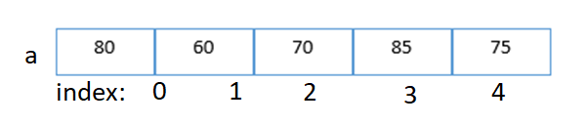
arrays
Array is a collection of similar data items or elements.
Elements are stored contiguously in memory under the same name.
Arrays are used to store multiple values in a single variable, instead of declaring separate variables for each value.
//multiple variables;
int a1,a2,a3,a4,a5;
int a[5];
a is array_name
size=5
Elements→ 80,60,70,85,75

Slide 2
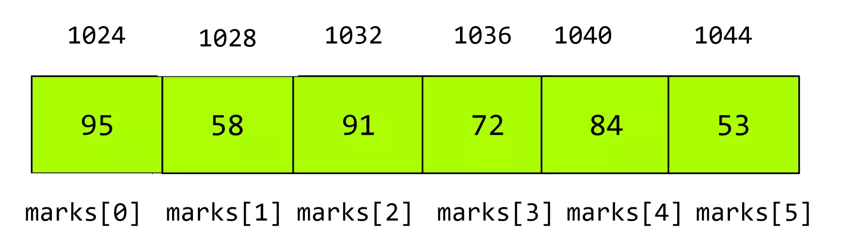
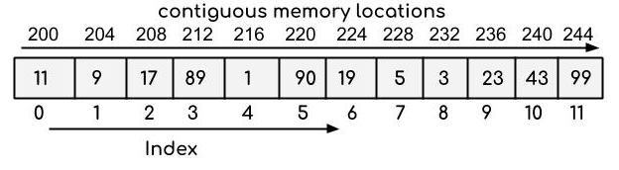
Properties of Array
Each element of an array is of same data type and carries the same size.
Elements of the array are stored at contiguous memory locations where the first element is stored at the smallest memory location.
int a[]={10,20,30,40}
ex. int = 4 bytes.

Slide 3
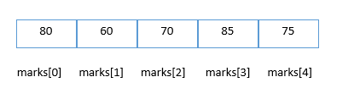
Properties of Array
ACCESSING OF ARRAY ELEMENTS:
Array elemlents can be accessed with index of that element
ex - a[5]
Elements of the array can be randomly accessed since we can calculate the address of each element of the array with the given base address and the size of the data element.

Slide 4
Declaration and of C Array
DECLERATION OF AN ARRAY:
We can declare an array in the c language in the following way.
data_type array_name[array_size];
int marks[5];
Here, int is the data_type, marks are the array_name, and 5 is the array_size.

Slide 5
INITIALIZATION OF AN ARRAY:
WAY1 :
INITIALIZE AN ARRAY DURING DECLARATION.
For example,
int mark[5] = {19, 10, 8, 17, 9};
or
int mark[] = {19, 10, 8, 17, 9};
Here, we haven't specified the size. However, the compiler knows its size is 5 as we are initializing it with 5 elements.
WAY2 : INITIALIZE USINGN INDEX.
marks[0]=19;//initialization of array
marks[1]=10;
marks[2]=8;
marks[3]=17;
marks[4]=9;

Slide 6
Advantage of C Array
1) Code Optimization: Less code to the access the data.
2) Ease of traversing: By using the for loop, we can retrieve the elements of an array easily.
3) Ease of sorting: To sort the elements of the array, we need a few lines of code only.
4) Random Access: We can access any element randomly using the array.
Disadvantage of C Array
1) Fixed Size: Whatever size, we define at the time of declaration of the array, we can't exceed the limit. So, it doesn't grow the size dynamically like LinkedList which we will learn later.

Slide 7
TYPES OF ARRAYS
Arrays are broadly classified into three categories
1. One dimensional arrays
2. Two dimensional arrays
3. Multi dimensional arrays

Slide 8
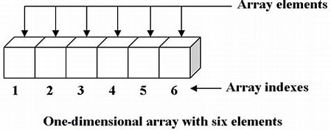
1. ONE DIMENSIONAL ARRAYS
An array of one dimension is known as a one-dimensional array
In one-dimensional array the elements are stored in a single row one after another.

Slide 9
1. ONE DIMENSIONAL ARRAYS
Declaration:
Ex-
int a[10];
created an array of 10 integers
float x[5];
created an array of 5 floating point values
double z[8];
created an array of 8 double values.
datatype array_name[size];

Slide 10
1. ONE DIMENSIONAL ARRAYS
Initialization:
int a[5] ={20,30,40,50,60}; //initiliztion with out index
or
int a[5];
a[0]=80;//initialization using index
a[1]=60;
a[2]=70;
a[3]=85;
a[4]=75;

Slide 11
Write a c program to create an integer array of size 5 and display the elements of the array
int a[5] = {10,20,30,40,50};

Slide 12
1. ONE DIMENSIONAL ARRAYS
//PROGRAM FOR CREATING AN ARRAY
#include<stdio.h>
int main ( )
{
int a[5] = {10,20,30,40,50};
int i;
printf ("elements of the array are");
for( i=0; i<5; i++)
printf ("%d", a[i]);
return 0;
}

Slide 13
1. ONE DIMENSIONAL ARRAYS
Write a C program to create an array of FLOAT TYPE , read and display elements using for loop
Input:
Enter 5 elements 22.55 44.6 66.4 76.4 55.6
Output:
Elements are 22.55 44.6 66.4 76.4 55.6

Slide 14
1. ONE DIMENSIONAL ARRAYS
#include<stdio.h>
int main ( )
{
float a[5],i;
printf ("enter 5 elements");
for ( i=0; i<5; i++)
scanf("%d", &a[i]);
printf("elements of the array are");
for (i=0; i<5; i++)
printf("%d", a[i]);
return 0;
}

Slide 15
1. ONE DIMENSIONAL ARRAYS
Write a C Program To find the average of n numbers using arrays
Input:
Enter number of elements: 5
Output:
avg=?

Slide 16
//Program to find the average of n numbers using arrays
#include <stdio.h>
int main()
{
int marks[10], i, n, sum = 0;
float avg;
printf("Enter number of elements: ");
scanf("%d", &n);
for(i=0;i<n; ++i)
{
scanf("%d", &marks[i]);
sum += marks[i];
}
avg = (float) sum / n;
printf("Average = %.2lf", average);
return 0;

Slide 17
Q) This C Program finds the number of elements present in the given array.
Given array:
int arr[] = {1, 2, 3, 4, 5};
OUTPUT:
Number of elements present in given array: 5
HINT: int length = sizeof(arr)/sizeof(int);
LOGIC
1. Create an array along with the definition of all its elements. 2. Using the inbuilt function sizeof(), passing the name of the array whose size we need to calculate, returns the number of elements contained by array. 4. The returned value is stored in the variable created above.

Slide 18
Write a C program to find the number of elements in an array
#include <stdio.h>
int main()
{
//Initialize array
int arr[] = {1, 2, 3, 4, 5};
//Number of elements present in an array can be calculated as follows
int length = sizeof(arr)/sizeof(int);
printf("Number of elements present in given array: %d", length);
return 0;
}

Slide 19
Write a C program to find largest element in an array
INPUT:
Enter no of elements (N = 5),
Enter the elements
12, 56, 34, 78 and 100
OUTPUT: The largest element present in the given array is: 100
LOGIC
1. Create an array of user-defined size. Int a[n] 2. Run the for loop till the user-defined size to insert the element at each location. 3. Considering the first element of the array to be the largest, compare all the remaining elements of the array.
max=a[0]
Compare with a[1], a[2]… if any element is larger that a[0] make it max
4. At last, the largest element will hold the actual largest value in the array. Thus, print it.

Slide 20
//C program to find largest element in an array
#include <stdio.h>
int main()
{
int n,I,max;
printf("\n Enter the size of the array: ");
scanf("%d", &n);
int a[n]; //Declaring array
printf("\n Enter elements \n", n);
for (i = 0; i<n; i++)
{
scanf(" %d", &a[i]);
}
//make Largest element as the first element
max = arr[0];
for (i = 1; i< sn; i++)
{
if (max < arr[i])
max = arr[i];
}
printf("\n largest element is : %d", max);
return 0;
}

Slide 21
============================================================== write a c program to find second largest element in the given array ====================================================================
INPUT: Enter the size of array:6
Enter the elements:
50
40
20
60
70
30
OUTPUT: The second largest element is: 60
LOGIC
Declare an array a[n]
make max1 = max2 = INT_MIN;
In loop compare max1 with a[i]
if(a[i] > max1)
max2 = max1;
max1 = a[i];
else if(a[i] > max2 && a[i] < max1)
{
max2 = a[i];
}

Slide 22
//C program to find second largest number in an array
#include <stdio.h>
#include <limits.h> // For INT_MIN
int main()
{
int n,a[n],i;
int max1, max2;
printf("Enter size of the array ");
scanf("%d", &n);
printf("Enter elements in the array: ");
for(i=0; i<n; i++)
{
scanf("%d", &a[i]);
}
max1 = max2 = INT_MIN;
for(i=0; i<n; i++)
{
if(a[i] > max1)
{
max2 = max1;
max1 = a[i];
}
else if(a[i] > max2 && a[i] < max1)
{
max2 = a[i];
}
}
printf("First largest = %d\n", max1);
printf("Second largest = %d", max2);
return 0;
}

Slide 23
Write a C Program to insert an element in an Array in a given location
INPUT:
Enter no of elements: 5
Enter the elements
1 2 3 4 5
Enter the element to be inserted : 6
Enter the location : 2
1 6 2 3 4 5
LOGIC
1. Read the size of the array. 2. Read the elements
3. Enter the location where to insert
4.create space at the specified location
for (i = num; i >= location; i--)
{
a[i] = a[i - 1];
}
num++;
a[location - 1] = element;
5. print out the result of insertion

Slide 24
//C Program to insert an element in an Array
#include<stdio.h>
int main()
{
int a[30], element, num, i, location;
printf("\nEnter no of elements :");
scanf("%d", &num);
for (i = 0; i < num; i++)
{
scanf("%d", &a[i]);
}
printf("\nEnter the element to be inserted :");
scanf("%d", &element);
printf("\nEnter the location");
scanf("%d", &location);
//create space at the specified location
for (i = num; i >= location; i--)
{
a[i] = a[ i – 1];
}
num++;
a[location - 1] = element;
//print out the result of insertion
for (i = 0; i < num; i++)
printf("n %d", a[i]);
return (0);
}

Slide 25
Write a C Program to delete an element in an Array
Enter number of elements in array
5
Enter 5 elements
10
20
30
40
50
Enter the location where you wish to delete element
3
Resultant array is
10
20
40
50
LOGIC:
Step 1. Read the size of the array arr[]
Step 2. Read the elements
Step 3.Input the position of the particular element to delete from an array.
step 4: Compare the position of an element (pos) from the total no. of elements (num+1).
if(pos>num+1)
{
deletion of the element is not possible
}
Step 5: Else remove the particular element and shift the rest elements' position to the left side in an array.
Step 6: Display the resultant array
Step 7: Terminate or exit from the program.

Slide 26
//C Program to delete an element in an Array
#include <stdio.h>
int main()
{
int a[50], position, i, n;
printf("Enter number of elements in array\n");
scanf("%d", &n);
printf("Enter %d elements\n", n);
for ( i = 0 ; i < n ; i++ )
scanf("%d", &a[i]);
printf("Enter the location to delete element\n");
scanf("%d", &position);
if ( position >= n+1 )
printf("Deletion not possible.\n");
else
{
for ( i= position - 1 ; i < n - 1 ; i++ )
a[i] = a[i+1];
printf("Resultant array is\n");
for( i = 0 ; i < n - 1 ; i++ )
printf("%d\n", a[i]);
}
return 0;
}

Slide 27
============================================================== Write a C Program to REVERSE THE ARRAY ELEMENTS ====================================================================
Input array: [1,2,3,4] output: [4,3,2,1]
Input array: [3,2,1] Reversed array: [1,2,3]
LOGIC
1. Enter size of the array: . 2. Read the elements
3. Start point= first element; end points= last element.
4. while(start<end)
{
//Swapping elements
int temp=arr[start];
arr[start]=arr[end];
arr[end]=temp;
//Incrementing start and decrementing end
start++;
end - -;
}
5. Print reversed array

Slide 28
//c program to C Program to REVERSE AN ARRAY
#include <stdio.h>
int main()
{
int size,i;
printf("Enter size of the array: ");
scanf("%d",&size);
printf("Enter Array Elements: ");
int arr[size];
//Input array elements
for(i=0;i<size;i++)
scanf("%d",&arr[i]);
printf("Entered Array is: ");
for(i=0;i<size;i++)
printf("%d ",arr[i]);
//Start point= first element; end points= last element
int start=0,end=size-1;
while(start<end)
{
//Swapping elements
int temp=arr[start];
arr[start]=arr[end];
arr[end]=temp;
//Incrementing start and decrementing end
start++;
end - -;
}
//Printing reversed array
printf("\nReversed array is: ");
for(i=0;i<size;i++)
printf("%d ",arr[i]);
return 0;
}

Slide 29
Write a program in C to separate odd and even integers in separate arrays
INPUT:
Input the number of elements to be stored in the array :5
Input 5 elements in the array :
element - 0 : 25
element - 1 : 47
element - 2 : 42
element - 3 : 56
element - 4 : 32
Expected Output :
The Even elements are :
42 56 32
The Odd elements are :
25 47
LOGIC
1. Enter size of the array: . 2. Read the elements
3. In loop
chck if (arr1[i]%2 == 0)
then
arr2[j] = arr1[i]; //store even numbers in arr2
else
arr3[k] = arr1[i]; //store odd numbers in arr3
4. print arr2 elements for even numbers
5. print arr3 elements for odd numbers

Slide 30
//program to separate odd and even in array
#include <stdio.h>
int main()
{
int arr1[10], arr2[10], arr3[10];
int i,j=0,k=0,n;
printf("Input the number of elements ");
scanf("%d",&n);
printf("Input %d elements in the array :\n", n);
for(i=0;i<n;i++) {
scanf("%d",&arr1[i]);
}
for(i=0;i<n; i++)
{
if (arr1[i]%2 == 0)
{
arr2[j] = arr1[i];
j++;
}
else
{
arr3[k] = arr1[i];
k++;
}
}
printf("\nThe Even elements are : \n");
for(i=0;i<j;i++)
{
printf("%d ",arr2[i]);
}
printf("\nThe Odd elements are :\n");
for(i=0;i<k;i++)
{
printf("%d ", arr3[i]);
}
printf("\n\n");
}

Slide 31
Write a program in C to copy the elements of one array into another array.
INPUT:
Input the number of elements to be stored in the array :3
Input 3 elements in the array : element - 0 : 15 element - 1 : 10 element - 2 : 12
Expected Output : The elements stored in the first array are : 15 10 12
The elements copied into the second array are : 15 10 12
LOGIC
1. Enter size of the array1: . 2. Read the elements 1arra
3. Copy elements of first array into array2
4 for(i=0; i<n; i++)
{
arr2[i] = arr1[i];
}
5. Print the elements of first array
6. Print the elements of second array

Slide 32
// copy the elements of one array into another array.
#include <stdio.h>
int main()
{
int a1[100], a2[100];
int i, n;
printf("Input the number of elements for array1 :");
scanf("%d",&n);
printf("Input %d elements in the array1 :\n",n);
for(i=0;i<n;i++)
{
printf("element - %d : ",i);
scanf("%d",&a1[i]);
}
// Copy elements of first array into a2.
for(i=0; i<n; i++)
{
a2[i] = a1[i];
}
//Prints the elements of first array
printf("\n The elements stored in the first array are :\n");
for(i=0; i<n; i++)
{
printf("%d", a1[i]);
}
//Prints the elements copied into the second array.
printf("\n copied elements into the second are :\n");
for(i=0; i<n; i++)
{
printf("%d", a2[i]);
}
printf("\n");
}

Slide 33
Write a program in C to count a total number of duplicate elements in an array.
LOGIC
1. Enter size of the array: . 2. Read the elements arraY
3. Copy elements into array2
4 for(i=0; i<n; i++)
{
arr2[i] = arr1[i];
}
5. mark the elements are duplicate
for(i=0;i<n; i++)
{
for(j=0;j<n;j++)
{
if(a1[i]==a2[j])
{ a3[j]=mm;
mm++; }
}
mm=1;
}
6. Print the elements of first array
6. Print the elements of second array
INPUT:
Enter the n:3
Input 3 elements in the array : element - 0 : 5 element - 1 : 1 element - 2 : 1
OUTPUT:
number of duplicate elements : 1

Slide 34
//count number of duplicate elements in an array.
#include <stdio.h>
int main()
{
int a1[100]; int a2[100]; int a3[100];
int n,mm=1,count=0;
int i, j;
printf("Input the number of elements in the array :");
scanf("%d",&n);
printf("Input %d elements in the array :\n", n);
for(i=0;i<n;i++)
{
printf("element - %d : ",i);
scanf("%d",&a1[i])
}
// copy in other array and fill the 3rd array with zeros
for(i=0;i<n; i++)
{
a2[i]=a1[i];
a3[i]=0;
}
// mark the elements are duplicate
for(i=0;i<n; i++)
{
for(j=0;j<n;j++)
{
if(a1[i]==a2[j])
{
a3[j]=mm;
mm++;
}
}
mm=1;
}
//Prints the array
for(i=0; i<n; i++)
{
if(arr3[i]==2)
{
count++;
}
}
printf(“Number of duplicate elements are %d \n", count);
printf("\n\n");
}

